Slide 1

What is Metaverse
Name: Asif Mehmood
PIAIC: 194115

Slide 2
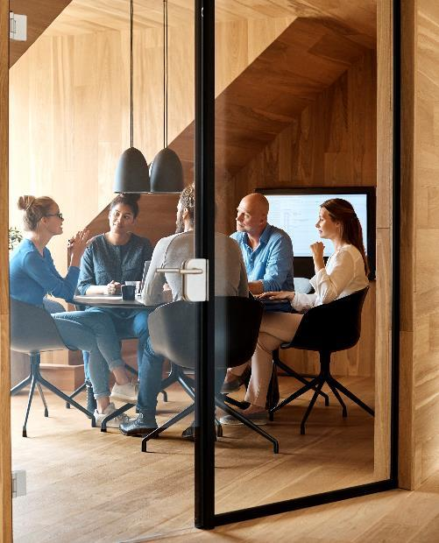



Introduction
It is an immersive experience with persistence where people can interact with each another in 3D virtual space through an avatar to enjoy entertainment and can make purchases and carry out transactions without moving physically. It is just another layer on web 2.0 and it is predicted that by 2030 it will have much more clear use cases and business model.

Slide 3


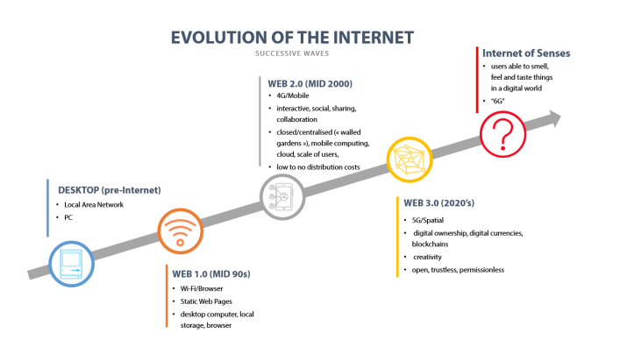
Evolution of internet

Slide 4
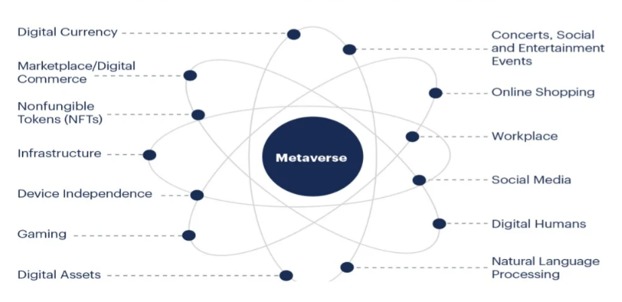
Elements of a metaverse

Slide 5
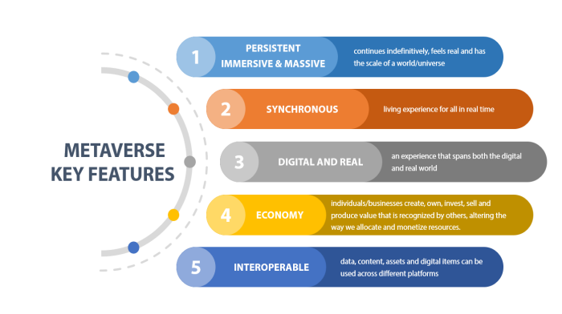
Key Features

Slide 6
Applications
Gaming
Health
Education
Remote working
Real estate
Healthcare
Banking and Finance
Social Media

Slide 7

The way to get started is to quit talking and begin doing.
Walt Disney

Slide 8


Thank You
Asif Mehmood
asif-Mehmood@hotmail.com
PIAIC No: 194115

